Slide 1

Industrial Training Presentation Sarvesh Anand Mankar 194009 DCP [T.Y.] sam-tech-2543.github.io

Slide 2
Certificate

Slide 3
Excite systems is one of the most trusted name in web design, website development, branding, etc. Founded by Sanjeet Kumar and Manish Gupta in 2007. We are serving corporate and retail clients in Pune. Our team is comprised of creative top designers, marketers, technologists, and strategists. We are the best website designing company in Pune. Along with that, our services are logo design, graphic design, SEO, social media marketing, digital marketing, brochure design print solutions, and dynamic web development to build customer's online presence to fit unique goals and budget. We have served to more than 550 clients and we have a rating of 4.7 stars.

Slide 4
Work done in Company
Clients with whom I worked:-
Kumeru Consultants.
Elexa Technologies Pvt. Ltd.
Excite Systems Portfolio
Kshrisagar Orthopedic
Octopus Adverts
Main topics to work on:-
Adding animations.
Changing themes.
Adding new sections.
Feedback forms. {Database connectivity}
Changing cards and adding new pictures.

Slide 5
Features learned
Grid systems of Bootstrap
Containers
Cards
Codepen
Typography
Inspect Element Tool
Header and Footer Settings
Animations for Cards:- Fade-In, Fade-Out, etc.

Slide 6
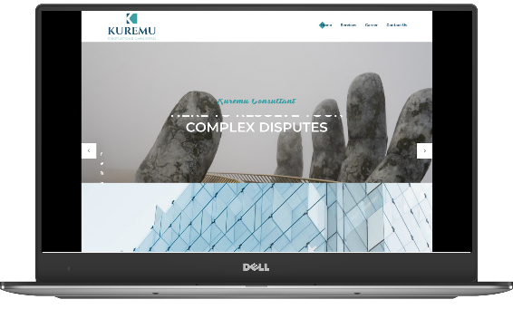
Kuremu Consultants
This was one my first project in this company. My work was to change the cards and add some animations for them. I had to update some contents as per client’s requirements. I learnt to make a carousel in this project and Mr. Subham Dhaggal taught me the way to make a web page responsive and way to approach towards some errors of JavaScript files. I also had to edit the Header and Footer of the Webpage. That was all in my part. The client appreciated our work so the things started off pretty well.

Slide 7

Elexa Technologies Pvt Ltd.
This was my second project in this company. They offer IT Services with some of Testing Softwares. Their demands were of having a webpage which shows all of their facilities and some sections which will show their projects in a proper way. I started off with checking out some other templates created by my senior’s and was trying to use them in this project. I learned using Inspect Element Tool from Mr. Subham. I just edited the Menu bar and designed some cards to show the details of Company Projects. This project improved my code reading skills as I worked with many code snippets.

Slide 8
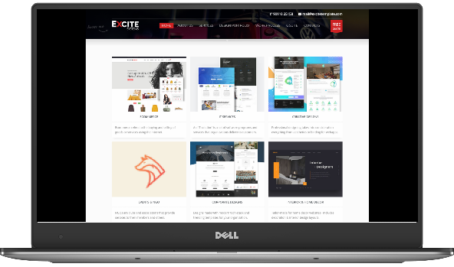
Excite Systems Portfolio
This time I was not working for any client but I had a task to work on Web Design Portfolio of my Company. The website was designed an year ago so needed to update the contents and widgets. My Company is focused at working on Website Development, Hosting and Advertisements so the portfolio needed the most attractive theme. The project was a great success as my Team was guided by Company’s Founder Mr. Sanjeet Kumar and the viewers appreciated it a lot.

Slide 9
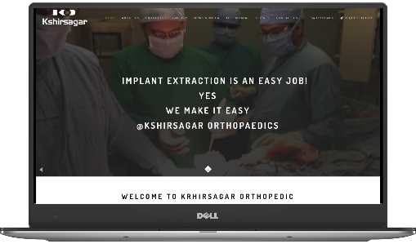
Kshrisagar Orthopedic
Kshirsagar Orthipedic Surgery Tools Service Provider Company was the last project on which I worked. They wanted many changes in their website. They had a demand of having navigation bar same as Rolex Inc. has on their website. I was provided with a basic template and needed to carry on changes in it. Mostly I worked on changing the contents and adding some hovering effects on the widgets. The cards were not looking that attractive so changed those. I was appreciated for that one. I also changed the Footer of the website. As we were proceeding to the Feedback form and other sub-pages the internship period ended up!

Slide 10
My Portfolio
Workflow:-
Started off with connecting the domain from Porkbun to Github.
Deciding a theme, wire-framing and contents.
Created header, one simple division and footer.
Surfing for some of tools which makes the work easy. Found Glyphicon, Sweetalert2, AOS library, etc.
Adding content.
Coded .css and .js files for having a good looking site.
Adding a feedback section.
Animating widgets {hovering effects, etc.}
Giving finishing touch {margins, font-style, etc.}
Make firebase project & connecting it to website.
Adding a page loader.
Getting reviews from the viewers & implementing their ideas too.

Slide 11

Page Loader
<script>
document.getelementbyid("myloader").scrollintoview();
document.getelementbyid("mybody").style.overflow="hidden";
settimeout(function(){
$('.loader_bg').fadetoggle();
document.getelementbyid("mybody").style.overflow="visible";
}, 5000); </script>

Slide 12
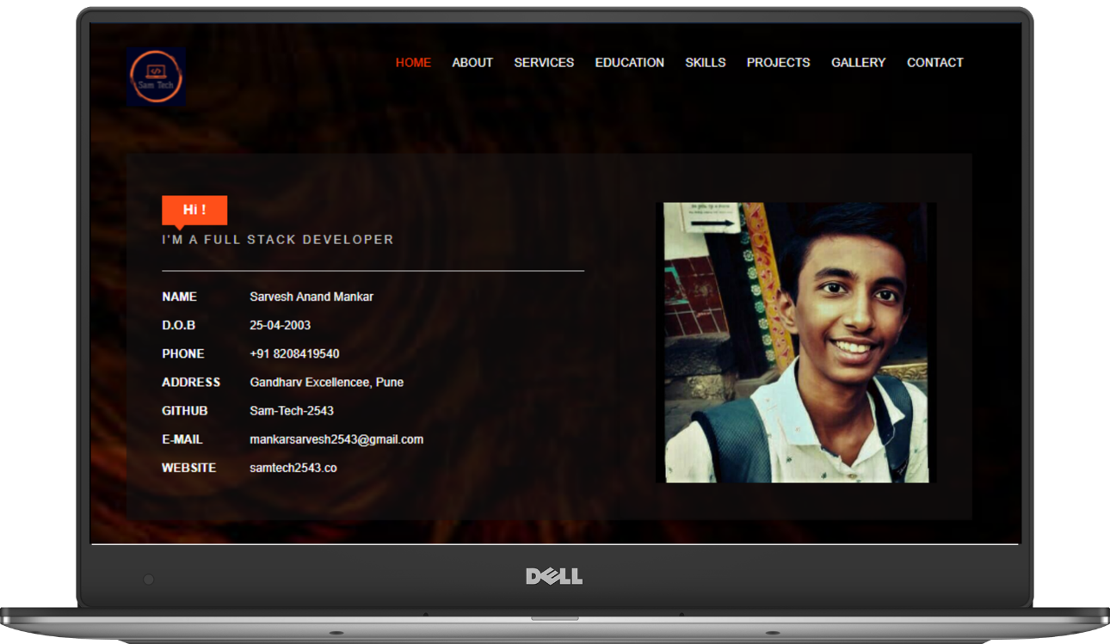

Slide 13
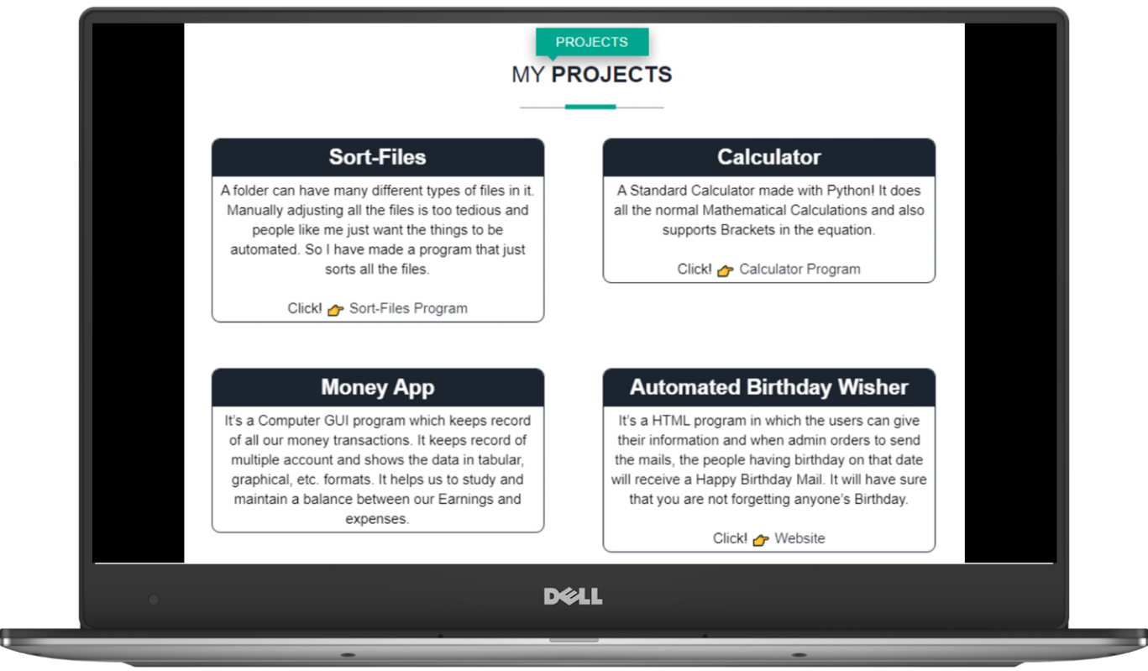

Slide 14
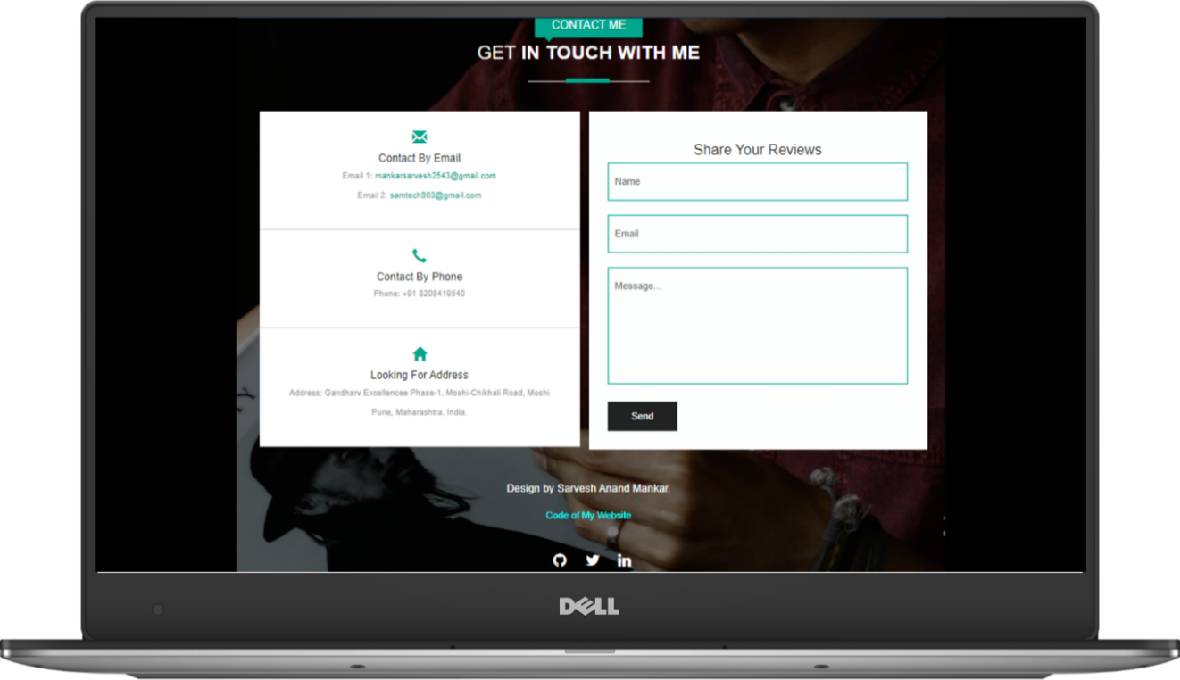

Slide 15

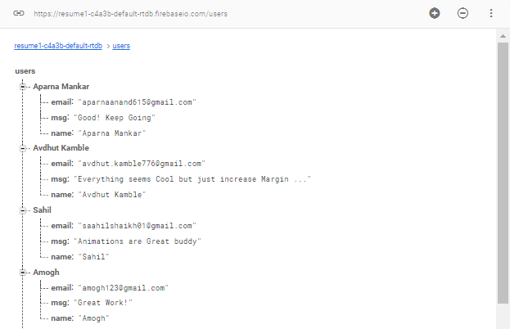
Contact me Form
I have used Google Firebase as my database for my contact us form.

Slide 16
Outcome Of Internship
Tech Stack used by me during Internship:-
HTML/CSS/JS/JQuery Programming Languages
Figma, Adobe XT And WordPress
Chrome’s Inspect Element Tool
GitHub Hosting Static
Working With Templates
Domian DNS Routing
Firebase And Other Database Connections

Slide 17
Advantages
Skills and tricks got from this internship made me feel easier to develop websites. Web design is the fastest way to make a GUI so, instead of having a CLI for mini-projects I’ll can have a good GUI with HTML, CSS and JS.
Had a great experience of working in a company. Worked professionally with the skills we had prior and got to learn about them more. Explored different tools and technologies. Learned a right way to approach clients and to solve their problems.

Slide 18
Conclusion
After completing this Industrial Training, I successfully learned how to design Websites. I also worked with different tools like Figma, WordPress, etc. I learned the perfect way to read code and use it in a proper way. I came up with some new ideas for designing websites. I learnt to make a Responsive and Dynamic Webpages which gives a great user experience. I also learnt to store and access Data over internet using Firebase. Got comfortable with the corporate workflow which takes place in most of Tech-based Organizations.
I acquired the skills to renovate the older templates, testing the webpages, Domain Management, dealing with clients and many more.
Now it is very easy for me to create a good Graphical User Interface within a few hours.

Slide 19
Thank You! Sarvesh Anand Mankar 194009 DCP[T.Y.]

